Slide 1
Voice of the CISO 2023

Slide 2
1,600 CISOs surveyed
16 countries covered
US, Canada, the UK, France, Germany, Italy, Spain, Sweden, the Netherlands, UAE, KSA, Australia, Japan, Singapore, South Korea and Brazil
One of the largest global CISO reports
in the industry
Voice of the
CISO 2023
Global insights into CISO challenges, expectations
and priorities
Notes:
3rd annual Voice of the CISO report.
1,600 CISOs at organizations with more than 200 employees surveyed across 16 countries.

Slide 3

Back to “Business as Usual”

Slide 4
2023: Back to “Business as Usual”
68%
of surveyed CISOs feel their organization is at risk of suffering a
material cyber attack in the next 12 months, with 25% rating the risk as very likely.
Percentage of CISOs who agree that their organization is at risk of a material cyber attack in the next 12 months
Global Average
2021 = 64%
84%
83%
2022 = 48%
81%
79%
80%
80%
2023 = 68%
75%
75%
78%
74%
73%
72%
72%
72%
68%
68%
69%
68%
64%
65%
65%
63%
64%
60%
58%
58%
58%
58%
56%
55%
53%
50%
50%
49%
44%
44%
44%
46%
40%
38%
34%
31%
28%
27%
Germany
Singapore
South Korea
France
Canada
Netherlands
Sweden
Australia
UK
UAE
U.S.
Spain
Brazil
Japan
KSA
Italy
2023
2022
2021
Notes:
Theme of report is back to “business as usual.” Look back to 2021--after start of pandemic--CISOs rightly concerned about risk of a cyber attack, with 64% sharing that view.
(NEXT CLICK) Then in 2022 a period of calm after pandemic disruption subsided and CISOs felt more comfortable protecting hybrid work environments--felt worst was behind them, and we see only 48% feeling at risk of an attack.
(NEXT CLICK) Now 2023—over two-thirds of CISOs feel at risk, they see the threat landscape heating up once again, and they’ve recalibrated their level of concern to match.

Slide 5

Cyber Preparedness
Percentage of CISOs who agree that their organization is unprepared to cope with a targeted cyberattack in 2023
Top 3 Countries
There is a concerning disconnect between the perceived likelihood of a cyber attack and how prepared organizations are to deal with one.
Nearly two-thirds (61%) agree their organization is unprepared to cope with an attack. Once again, this is above 2022’s figure of 50% and more in line with 2021’s finding of 66%.
UK
76%
France
76%
        “Organizations are finally back to ‘business as usual’ following years of coping with the pandemic and its aftermath. CISOs fully understand how critical their supply chains are and the significant impact of cyber-attacks and ransomware on those supply chains. There is a need for a continuous and constantly evolving partnership between companies and their suppliers on the topic of cybersecurity that results in stronger requirements and cyber controls. Working collaboratively across sectors to raise the level of security yields benefits for all and creates greater deterrence for the adversaries..”
        Deborah Wheeler, SVP & CISO,
        Delta Air Lines
Brazil
72%
Global Average = 61%
Notes:
Here again, looking at cyber preparedness, there is the trend of back to “business as usual” and a return to 2021 levels of concern.
CISOs feel worried about a cyber attack, but also feel unprepared, with 61% sharing that view. That’s closer to 2021 and a marked increase from just last year.
CISOs in the UK, France and Brazil have substantially elevated feelings of unpreparedness over their peers.

Slide 6
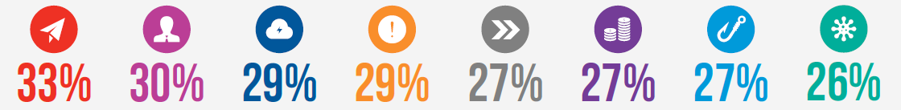

A CISO’s Eye View of the Threat Landscape
This year, we once again asked CISOs about the types of cyber attacks they were most concerned about. The results continue to show that attacks are coming from all angles.
What, if anything, do you perceive to be the biggest cybersecurity threats
within your organization/industry in the next 12 months? Pick up to three.
Email fraud
(business email
compromise)
Insider threat
(negligent,
accidental or
criminal)
Cloud account
compromise
(Microsoft 365
or G Suite or
other)
Distributed
denial-of-service
(DDoS) attack
Supply chain
attacks
Ransomware
attacks
Smishing/ Vishing
Malware
Notes:
Types of threats top of mind for CISOs: Email fraud, insider threats, cloud account compromise, and DDoS attacks.
Almost same as last year: in 2022 Insider threats led the way and email fraud came in second.
Proofpoint’s 2022 board report showed board members also view email fraud as the top threat, so CISO concerns filtering through to C-suite.

Slide 7

Protecting People -
The Cybersecurity Cornerstone

Slide 8
Protecting People
60%
of CISOs consider human error to be their organization’s biggest
cyber vulnerability.
Percentage of CISOs in agreement that human error is their organization’s biggest cyber vulnerability.
Global Average
2023 = 60%
2022 = 56%
2021 = 58%
78%
75%
78%
76%
75%
73%
70%
69%
67%
68%
70%
69%
65%
65%
63%
66%
65%
62%
61%
59%
59%
59%
56%
56%
53%
56%
56%
58%
49%
51%
48%
50%
51%
48%
48%
50%
46%
46%
45%
43%
45%
37%
38%
34%
France
Sweden
Canada
Singapore
Netherlands
Australia
Germany
South Korea
UK
Brazil
Japan
U.S.
Spain
UAE
KSA
Italy
2023
2022
2021
Notes:
Almost two-thirds of CISOs consider human error to be their organization’s biggest cyber vulnerability.
This is consistent with what we found in 2022 and 2021. Shows that improving confidence in worker’s cybersecurity savviness remains a challenge.
2022 Board report: 67% of directors share this view, suggesting C-Suite recognizes threat CISOs have witnessed firsthand.

Slide 9
The People Problem
61%
of CISOs believe that their employees understand their role
in protecting their organization against cyber threats, with 25%
strongly agreeing.
Just 61% of CISOs believe that employees understand their role in protecting their employer.
That leaves 2 in 5 CISOs ill at ease about whether their users are equipped to detect and deter cyber threats.
61%
in 2023
60%
in 2022
58%
in 2021
Notes:
61% of CISOs believe employees understand their role in protecting their employee. Number has remained consistent over time.
While may seem high, it means 2 in 5 CISOs aren’t confident their workers know how to manage cyber threats.

Slide 10

Defending Data

Slide 11
Protect People, Defend Data
63%
of global CISOs say their organization has dealt with a material loss of sensitive
information in the past 12 months.
Almost two-thirds—63%—of CISOs say they have had to deal with the loss of sensitive information in the past year.
Percentage of CISOs whose organizations have dealt with a material loss of sensitive information in the past 12 months
87%
85%
2023 Global Average = 63%
76%
75%
74%
74%
69%
65%
58%
58%
55%
54%
49%
47%
42%
41%
Sweden
Germany
France
Australia
Singapore
Canada
South Korea
Netherlands
U.S.
Japan
UK
KSA
Spain
Brazil
Italy
UAE
Notes:
A new thing examined this year was data loss.
Almost two-thirds of CISOs have experienced a loss of sensitive information at their organizations in the past year.
Industries experiencing the most data loss incidents were energy, business & professional services, and retail.
Leading consequence of these incidents was post-attack recovery costs, followed by financial loss and regulatory sanctions.

Slide 12
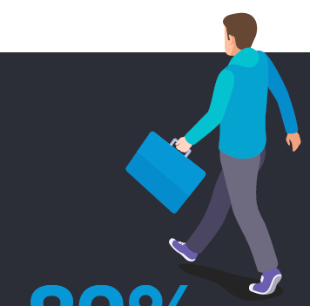
Malicious Insiders
Of those CISOs who experienced a data loss event, 82% report that employees leaving their organization played a role.
        Organizations typically deploy a variety of security solutions and mitigating controls to protect against the loss of sensitive data, but they often overlook one factor — employees who leave for greener pastures often take the data with them. CISOs can’t solve this problem with technical controls alone, and this is where a strong security culture comes in. Educating employees, setting the expectations, garnering senior business leadership support — and then adding procedures and controls around it — can mitigate and eliminate some of the most common data leak problems.
        Patrick Joyce, VP,
        Chief Global Security
        Officer (CISO & CSO), Medtronic
82%
of CISOs report that employees leaving their organization has
contributed to a data loss event
Notes:
For those CISO who experienced a data loss event, an astonishing 82% said that employees leaving their organization played a role.
It’s clear that the impact of the Great Resignation and recent mass layoffs is a contributing factor in this trend.
It will take more than technical controls alone to solve this problem and will instead require building a strong security culture.

Slide 13

Building a Defense to Fight on Every Front

Slide 14
Supply Chain Risk - a Recurring Priority as Budgets Constrained
58%
of global CISOs say the current economic downturn has negatively impacted their organization’s
cybersecurity budget.
64% of CISOs say they have adequate controls in place to mitigate supply chain risk—a slight increase from last year’s 59%—demonstrating the issue remains a top priority.
Percentage of CISOs who agree their organization has
appropriate controls in place to mitigate supply chain risk.
79%
78%
2023 Global Average = 64%
77%
75%
71%
69%
67%
65%
65%
59%
58%
56%
53%
51%
50%
48%
France
Sweden
Singapore
Canada
Australia
Netherlands
South Korea
Germany
UK
Japan
Brazil
U.S.
Spain
UAE
Italy
KSA
Notes:
Supply chain risk is a recurring priority.
64% of CISOs say they have appropriate controls in place to mitigate supply chain risk. Slight increase from 2022, showing the issue is a top priority.
58% of CISOs say the economic downturn has impacted their cybersecurity budgets.
CISOs may feel more strapped for resources and these supply chain controls may be at risk.

Slide 15
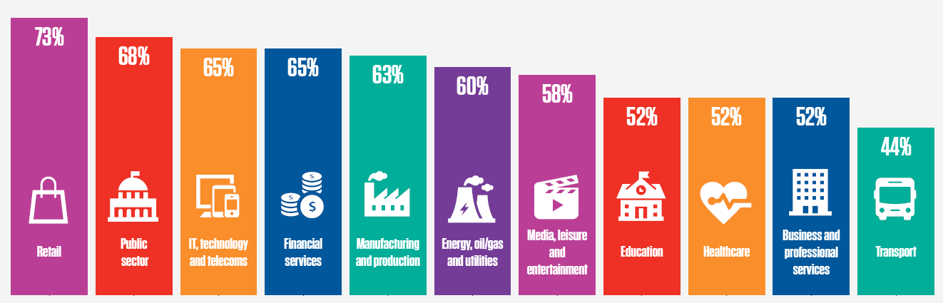
Ransomware: Cyber Insurance to the Rescue
62% of CISOs believe their organization would pay to restore systems and prevent data release if attacked by ransomware in the next 12 months.
And they are increasingly relying on insurance to shift the risk—61% said they would place a cyber insurance claim to recover losses incurred in various types of attacks.
Percentage of CISOs by industry who agree that if impacted by ransomware within the next 12 months, their organization is likely to pay a ransom to restore systems/prevent the release of data.
Notes:
Ransomware continues to be an ever-present concern, and we asked CISOs about it.
62% of CISOs say their organization would pay to restore systems or prevent data release if attacked by ransomware.
Almost the same number would place a cyber insurance claim to cover the cost. Not surprising, as World Economic Forum reports that 71% of organizations have cyber insurance in place.
Relying on such policies is growing complicated, as insurers are raising premiums, and some are even withdrawing coverage for ransomware.

Slide 16

Boards and CISOs —
Closer to the Same Page

Slide 17
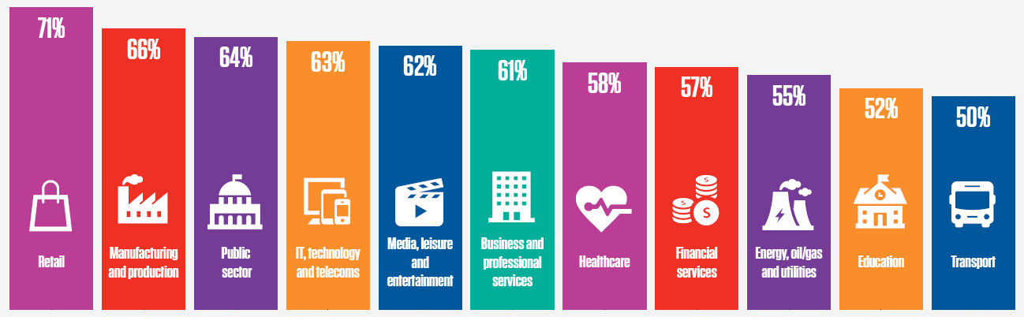
The Board-CISO Relationship is Improving
62%
of CISOs believe that cybersecurity expertise should be required at the board level.
Just under two-thirds (62%) of CISOs agree that their board sees eye-to-eye
with them on cybersecurity issues. That’s up from 59% in 2021 and 51% in 2022.
Percentage of CISOs by industry who agree their board sees
eye to eye with them on the issue of cybersecurity.
Notes:
One positive trend uncovered is that the board-CISO relationship is improving.
Nearly two-thirds of CISOs say their board sees eye-to-eye with them on cybersecurity issues.
That number was down to 51% in 2022 from the 2021 level of 59%. Drop in perceived relations perhaps result of late-pandemic stress and strain.
2022 Board report showed that 69% of board members feel the same way.
In addition, 62% of CISOs believe cybersecurity expertise should be required at the board level--suggests many believe technical knowledge is lacking in the boardroom.

Slide 18
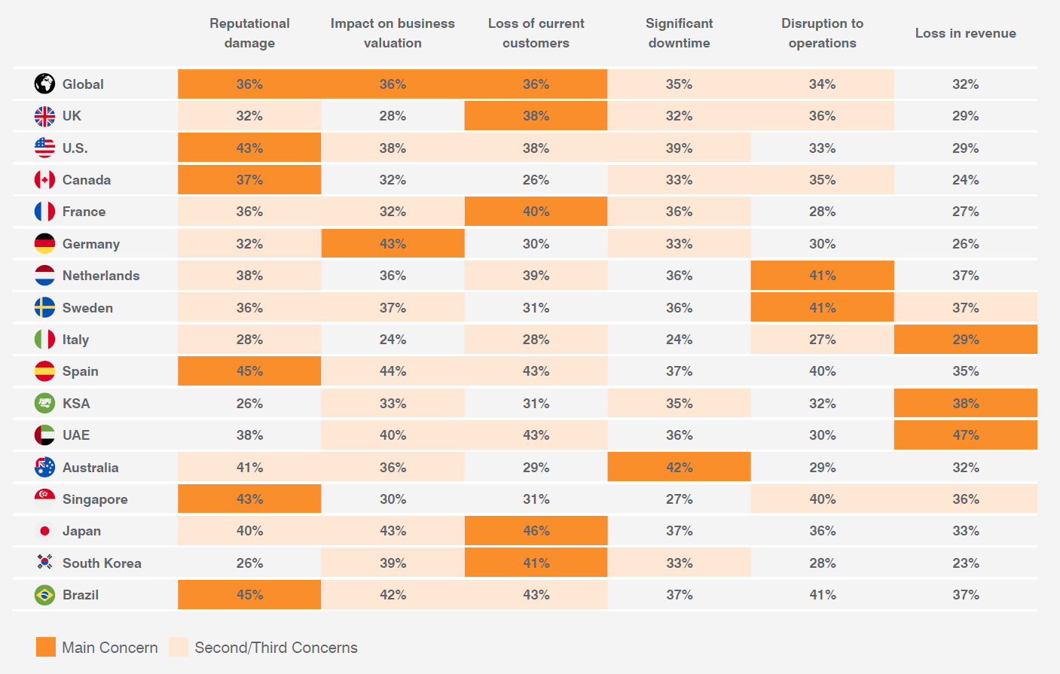
Cyber Risk: Top Board Concerns
        As regulatory scrutiny increases, board members are recognizing the crucial role played by their Chief Information Security Officer (CISO) in managing the mounting demands of cyber governance and oversight. By forging closer partnerships and aligning with their security experts, boards can effectively implement and oversee strategies that enhance their organization’s cybersecurity and fortitude, positioning them to overcome emerging threats, challenges and ensuring shareholder value.
        Martin Bally, VP &
        Chief Information Security Officer, Campbell Soup Company
Given your interactions with the board, what do you believe are their greatest concerns
with regard to a material cyber attack on the business? (Pick up to three.)
Notes:
If impacted by cyber attack, CISOs believe their boards are most concerned about reputational damage, the impact on business valuation, and loss of current customers.
That’s changed a bit from last year, when significant downtime and disruption to operations were the top concerns.

Slide 19

Life as a CISO—
In the Crosshairs, Burned out and Under the Microscope

Slide 20
Excessive Expectations and Burnout
61%
of CISOs agree that there are excessive expectations on the
CISO/CSO.
Almost two-thirds (61%) of CISOs agree they face excessive expectations. That’s up from 49% in 2022 and 57% in 2021.
These mounting expectations, coupled with high-stress environments and shrinking budgets, are hurting CISOs’ quality of life. 60% say they have experienced burnout in the past 12 months. Just 15% disagree.
Percentage of CISOs who agree that they have
experienced burnout within the past 12 months
74%
73%
2023 Global Average = 60%
70%
70%
67%
65%
65%
63%
62%
59%
54%
50%
50%
48%
47%
39%
Singapore
France
Sweden
Canada
Germany
Netherlands
Australia
South Korea
UK
U.S.
Brazil
Japan
Spain
UAE
Italy
KSA
Notes:
CISOs are facing mounting pressures--61% agree they face excessive expectations. That’s up from 49% last year and 57% in 2021.
This again demonstrates the back to “business as usual” trend, with CISOs feeling more pressure at the start of the pandemic, experiencing a year of relative calm last year, and now back to where they were before.
60% say they have experienced burnout in the past year.
Excessive expectations, budget concerns, high-stress environments, and personal liability concerns are all adding to CISO angst.

Slide 21
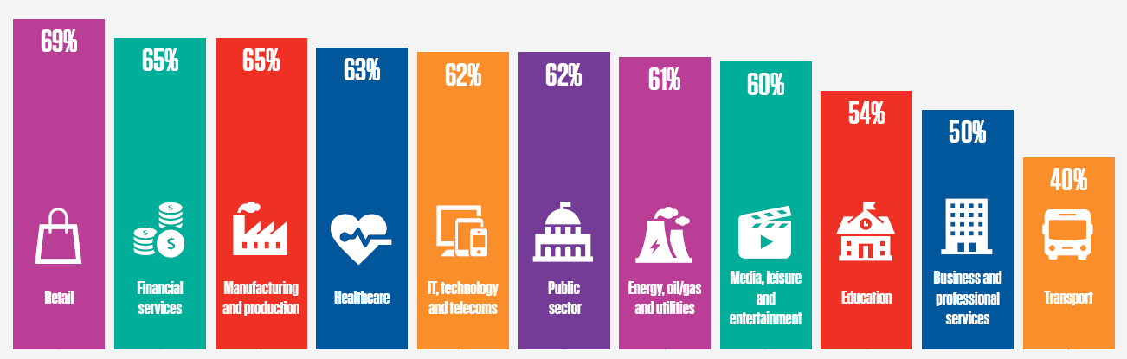
The Burden of Personal Liability
Another significant contributor to the pressure felt by CISOs is the possibility of personal liability - 62% expressed concern about the subject.
Most CISOs (61%) say they would not join an organization that does not offer directors and officers (D&O) insurance to protect them from financial liability stemming from a successful cyber attack.
Percentage of CISOs who agree that they would not join an organization that does not offer
directors and officers (D&O) insurance coverage (or similar personal liability insurance) to
protect them from financial liability in the event of a successful cyber attack.
Notes:
62% of CISOs are concerned about the possibility of personal liability.
Increased scrutiny from regulators is adding to those concerns.
To address this, 61% of CISOs say they won’t join an organization unless it offers D&O insurance to protect them financially.
CISOs in retail, financial services and manufacturing—industries with high volumes of sensitive data or heavy regulations—are most likely to demand insurance coverage.

Slide 22
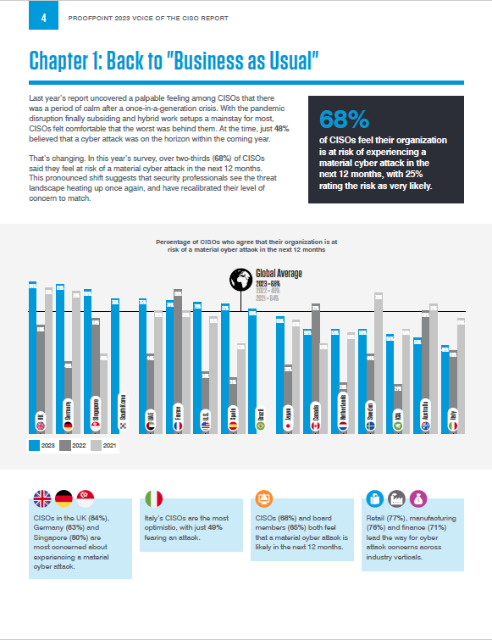
Global Key Findings
Proofpoint’s 2023 Voice of the CISO Report Reveals Nearly Two-Thirds of CISOs have had to Deal with the Loss of Sensitive Data in the Past 12 Months
82% of CISOs believe employees leaving the organization contributed to the data loss incident, a challenge exacerbated by staff turnover
CISOs have returned to the elevated concerns and feelings of unpreparedness they experienced early in the pandemic: 68% feel at risk of experiencing a material cyber attack in the next 12 months, compared to 48% last year and 64% in 2021. Further, 61% believe their organization is unprepared to cope with a targeted cyber attack, compared to 50% last year and 66% in 2021.
The loss of sensitive data is exacerbated by employee turnover: 63% of security leaders reported having to deal with a material loss of sensitive data in the past 12 months and of those, 82% agreed that employees leaving the organization contributed to the loss. Despite those losses, 60% of CISOs believe they have adequate controls to protect their data.
Email fraud tops the list of the most significant threats: while the top threats perceived by CISOs are almost the same as last year, email fraud (business email compromise) moved from the fourth spot to the top, followed closely by insider threats, cloud account compromise and DDoS attacks.

Slide 23
Global Key Findings - continued
Most organizations are likely to pay a ransom if impacted by ransomware: 62% of CISOs believe their organization would pay to restore systems and prevent data release if attacked by ransomware in the next 12 months. And they are increasingly relying on insurance to shift the risk—61% said they would place a cyber insurance claim to recover losses incurred in various types of attacks.
Supply chain risk is a recurring priority: 64% of CISOs say they have adequate controls in place to mitigate supply chain risk, a slight increase from last year’s 59%. While these protections may feel adequate for now, going forward, CISOs may feel more strapped for resources—58% say the shaky economy has negatively impacted their cybersecurity budget.
People risk remains a prominent concern: there is a slight uptick in the number of CISOs who view human error as their organization’s biggest cyber vulnerability—60% in this year’s survey vs. 56% in 2022 and 58% in 2021. Also consistent with previous years, 61% of CISOs believe that employees understand their role in protecting the organization, compared to 60% in 2022 and 58% in 2021; this lack of significant progress indicates a struggle to build a strong security culture.
CISOs and boards are more in tune: 62% of CISOs agree their board members see eye-to-eye with them on cybersecurity issues. The board-CISO relationships has improved: up from 51% last year and 59% in 2021.
Mounting CISO pressures are making the job increasingly unsustainable: 61% of CISOs feel they face unreasonable job expectations, a significant increase from last year’s 49%. While the return to their new reality may be one reason behind this view, CISOs’ job-related angst is a likely contributor as well—62% are concerned about personal liability and 60% say they have experienced burnout in the past 12 months.

