Slide 1
Managing Systemic Risk
Courtesy of
Using the DiRECTOR™ Framework to identify, communicate and mitigate complex vulnerabilities to your business environment Adapted from Digital Directors Network

Slide 2
Systemic risk is the threat that component failure will cascade and jeopardize the much larger system. It’s inherent in almost all large business environments. And it’s growing amid a wave of digital disruption and transformation.
Notes:
For business leaders, understanding systemic risk has never been more challenging—or more critical. The DiRECTOR™ Framework is designed to help assess and communicate those risks to executives, board members and other leaders.
Use this template to identify systemic risks and break down the complex and interconnected factors that could mean huge business implications for seemingly minor cybersecurity risks.

Slide 3
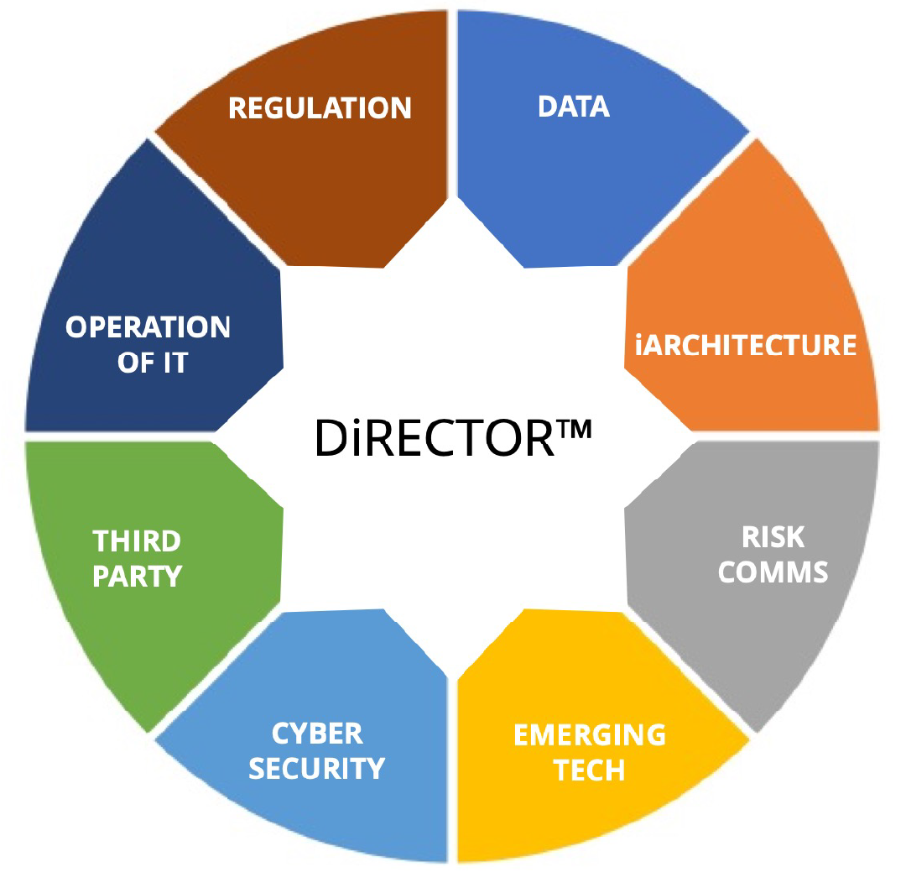
The DiRECTOR™ Framework
A director’s role serves shareholder and stakeholder value and understanding how the digital system supports and drives it.
Value can come from many different component elements that make up a business system. Value can change and it is increasingly enabled and delivered through the digital system.
The common language of the boardroom is built upon value creation and preservation.
Notes:
The DiRECTOR™ framework covers eight key domains that enable complex digital systems. Each represents a key risk areas within the digital system. These domains are co-dependent and regulate the functioning and health of the digital system and how it supports business value.
All eight domains are critical for assessing systemic risks. But for this exercise, we’ll focus on the two we know best at Proofpoint: data and cybersecurity.

Slide 4
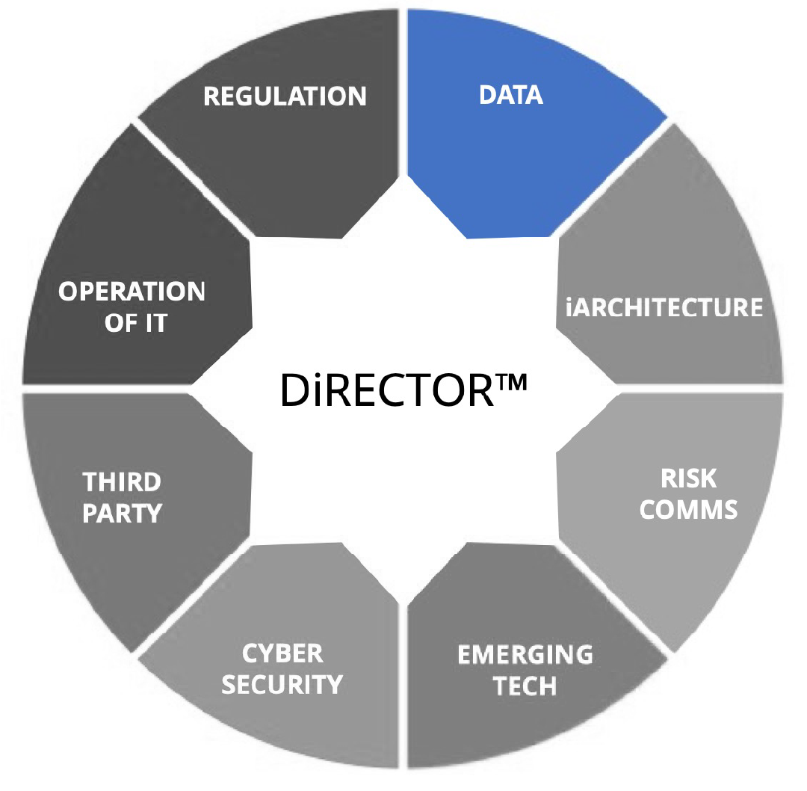
Data
Digital oversight starts with data and how digital systems and business environments convert data into knowledge, insight, and action.
Data can directly drive a value proposition. It is vital to operating a business. And it is actively targeted by cyber attackers for its intrinsic value.

Slide 5
Data: Assessing Systemic Risks
Who has access to sensitive information? How is their access verified, controlled and monitored?
VIPs and high-privilege users:
Roles:
Groups:
Notes:
Asking the right “value at risk” questions can identify systemic risks that stem from your data and users’ access to it. Use this slide to document privilege-based user risk.

Slide 6
Data: Assessing Systemic Risks
How and where do people with privileged access work? And what safeguards are in place when they access data?
In office:
Remote:
Hybrid:
Mobile:
Notes:
Asking the right “value at risk” questions can identify systemic risks that stem from your data and users’ access to it. Use this slide to document privilege-based user risk.

Slide 7
Data: Assessing Systemic Risks
What devices are they using? Which applications are they enabling? What ensures that those devices and apps aren’t accessing data improperly?
PCs:
Tablets:
Mobile devices:
Apps:
Notes:
Asking the right “value at risk” questions can identify systemic risks that stem from your data and users’ access to it. Use this slide to document privilege-based user risk.

Slide 8
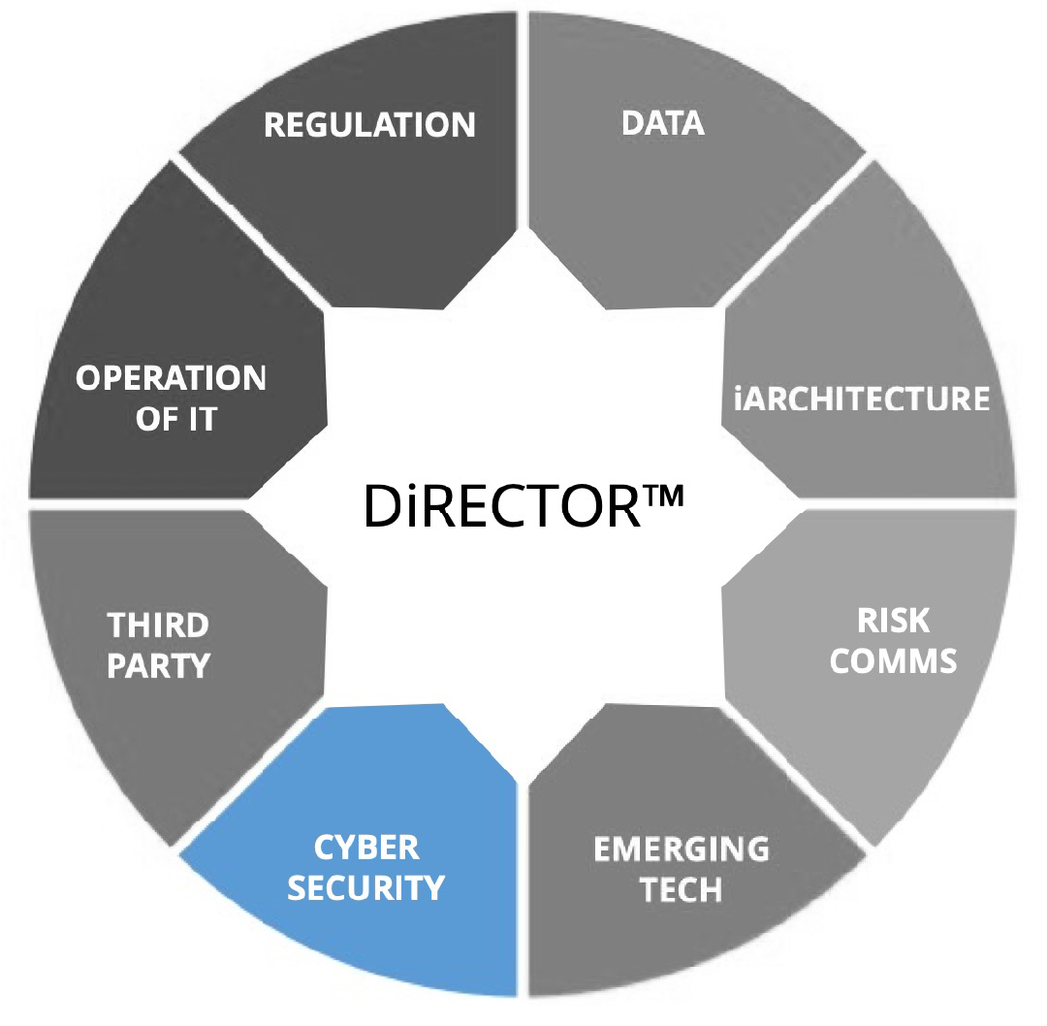
Cybersecurity
Where there’s business value, there’s risk. Cyber attackers find and exploit the weakest digital link.
The nonstop threat to every digital system and the business supported by it, creates significant value protection and preservation challenges from people to technology; both from internal threats and external.
Cybersecurity is not an afterthought. It’s an integrated component of every digital environment from start to finish.
Notes:
Cybersecurity is one of the eight components of the DiRECTOR Framework—and probably the most challenging among them. Fast-evolving, complex, hard-to-tackle, broadly impactful and poorly understood, cybersecurity has only grown more difficult in the wake of the COVID-19 pandemic. While it involves technology, people and processes the biggest factor in cybersecurity-based systemic risk.

Slide 9
Cybersecurity: Assessing Systemic Risks
What infrastructure are the most susceptible to failure, attack or malicious and negligent behavior? What is the potential impact? What mitigation measures are in place?
Hardware:
Software:
Supply chain (external vendors and IT services):
Notes:
Complex global supply chains and a shift to the cloud means that external risks are just as critical as your internal data risks.

Slide 10
Cybersecurity: Assessing Systemic Risks
What users are the most vulnerable, attacked or privileged? How are they identified, monitored and protected?
Vulnerability: What is the likelihood that specific people may be compromised:
Attacks: Who is being attacked, how and why:
Privilege: Who poses the greatest risk within the organization because of access to data, systems and other critical resources:
Notes:
When it comes to cyber threats and compliance risks, people are the new perimeter. And just as people are unique, so is their value to cyber attackers and risk to employers. They have distinct digital habits and weak spots. They’re targeted by attackers in diverse ways and with varying intensity. And they have unique professional contacts and privileged access to data on the network and in the cloud.
Together, these factors make up a user’s overall risk in what we call the VAP (vulnerability, attacks, and privilege) index.

Slide 11
Cybersecurity: Assessing Systemic Risks
What defenses, controls and continuity measures have we deployed? How effective are they? Are we focusing our security efforts of the areas of biggest risk?
Hardware:
Software:
Supply chains:
People:
Notes:
In today’s cloud-enabled, mobile, digitally transformed workplace, protection starts with people. That’s why you need a solution that addresses all aspects systemic risk.

Slide 12
Learn more
For more CISO-focused research, insights and resources, visit the Proofpoint CISO Hub at https://www.proofpoint.com/us/ciso-hub

